Slide 1

Django Learner Lab
Part 2
Getting started with remote access,
backend data modeling, and API endpoints

Slide 2
Why Do This?
This can be the part of the presentation where you introduce yourself, write your email…

Slide 3
Table of contents
01
02
03
04
05
06
Setup a VM with Remote Access
Clone & Setup Learner Lab
Explore ORM Functionality
API Endpoints & Testing
Generate API Documentation
Start a New Project

Slide 4

01
Setup a VM with Remote Access

Slide 5
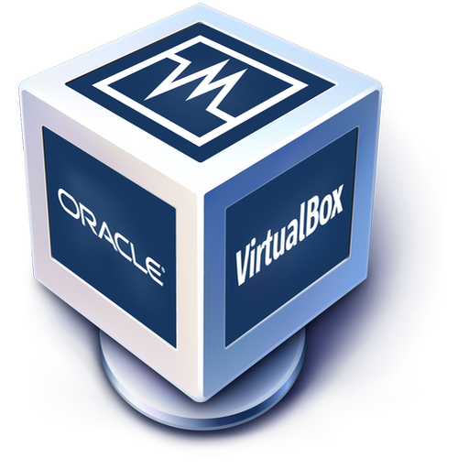

Install Virtualization Software
VirtualBox: https://www.virtualbox.org/
Vmware: https://www.vmware.com/products/desktop-hypervisor.html
Virtual machine networking considerations:
https://www.virtualbox.org/manual/ch06.html
Speaking of craters, many of them were named after artists or authors who made significant contributions to their respective fields. Mercury takes a little more than 58 days to complete its rotation, so try to imagine how long days must be there! Since the temperatures are so extreme and the solar radiation is so high, Mercury has sadly been considered to be non-habitable for humans
from pptx import Presentation

Slide 6
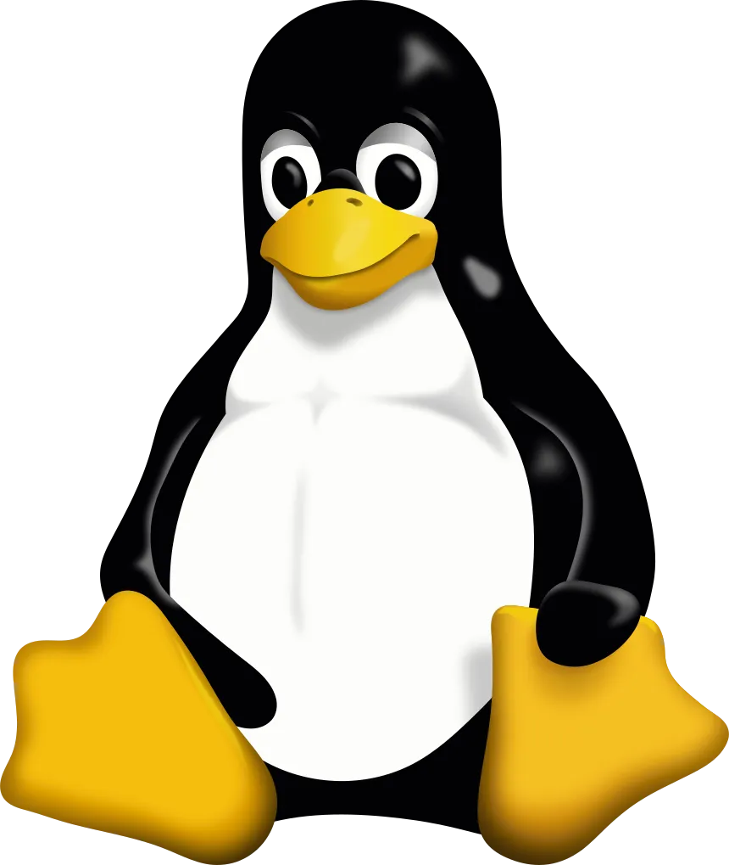


Configure a Virtual Machine
Linux Server
Minimum Requirements
Lightweight
Low requirements
CLI only
Ubuntu popular choice
Storage: 20g
RAM: 2g
CPUs: 1
# install openssh to enable remote connections
sudo apt install openssh-server
# discover your IP address
ip a
Notes:
ENABLE REMOTE CONNECTIONS ON DJANGO SERVER (VM)
Install the OpenSSH server, which is required for remote connections.
> sudo apt install openssh-server
This command will display the IP address (eg: 192.168.0.40)
> ip a

Slide 7

Install Python, pip, & venv
https://www.python.org/downloads/
Do you know what helps you make your point crystal clear? Lists like this one:
They’re simple
what is python/what defines it (dynamically typed, interpreted language, high level)
what is a virtual environment and benefits/how to use
And the most important thing: the audience won’t miss the point of your presentation
CLI:
Linux – apt package manager (Debian):
sudo apt install python3
Notes:
When downloading python, make sure to tick the box at the bottom! (Add python to PATH)

Slide 8

02
Clone & Setup Learner Lab

Slide 9
Working With Repo Workflow
Step 1
Step 2
Step 3
Step 4
Create a ‘git’ directory in your home directory
Clone the repo to the git directory
Move to the cloned repo and create a Python venv
Activate the venv and install the requirement.txt
Notes:
After the django server VM installation is complete
CREATE A DIRECTORY FOR GIT REPOSITORIES IN HOME
Mkdir git
Cd git
CLONE THE REPO
Git clone …etc

Slide 10
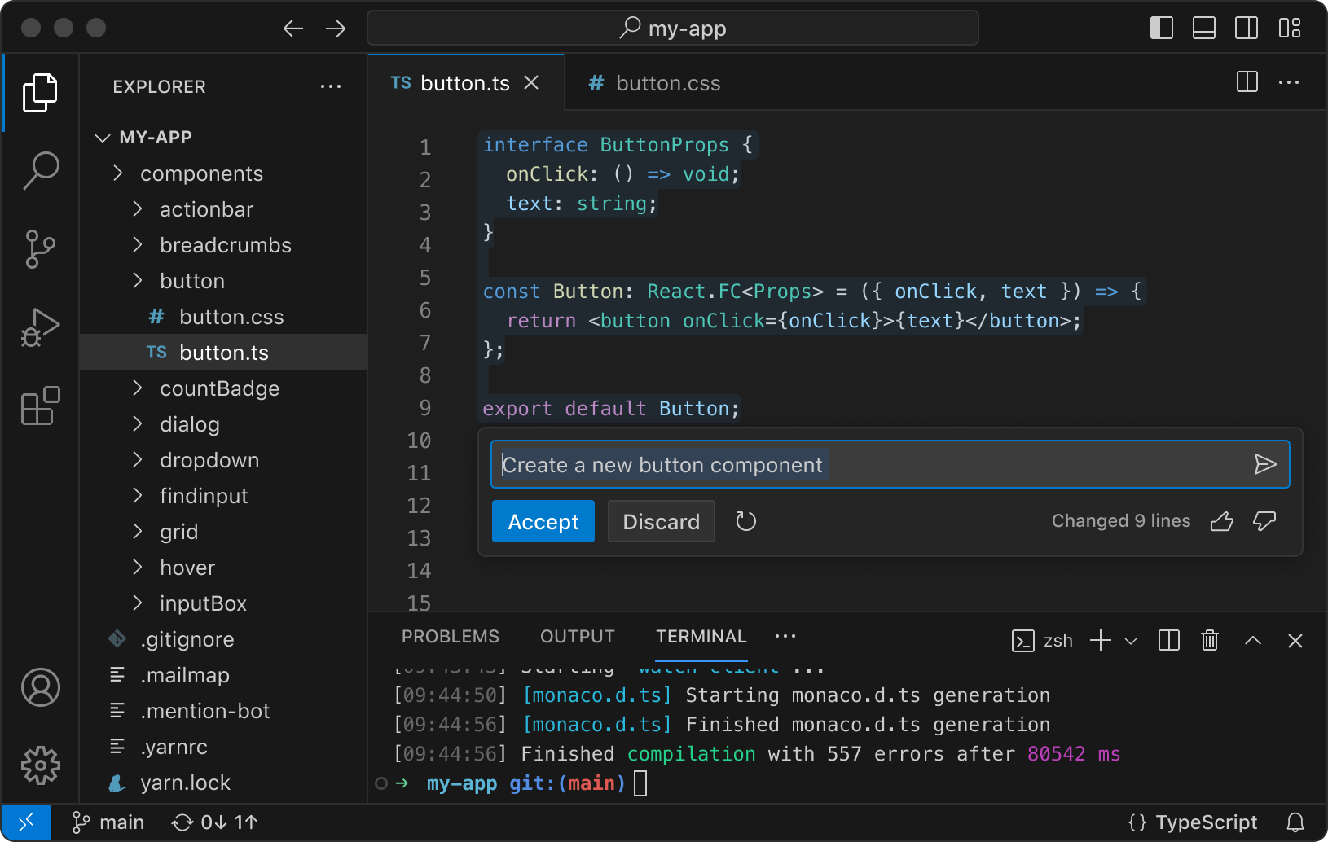

Why use an IDE like VS Code?
Explorer
Files/Code
Benefits:
Multiple files open at once
Easy directory navigation
Remote connections/SSH
Extensions provide support for multiple languages and services
Debugging and testing
Version control
Integration with services and virtual environments
One stop shop for project, centralizing the development process in one application
Code completion/suggestions, class information
Code colorization
Syntax/error detection
And the most important thing: you’re a sick cunt
Extensions
Terminal
Notes:
CONNECT FROM HOST MACHINE WITH VS CODE
Install Remote Explorer extension
Go to the Remote Explorer tab and click the ‘+’ to add a new address. A input field will drop down at the top – input the command to connect to the target machine: ssh <username>@<Django-server-ip> -A
You’re given the choice of which config file to update. Choose the one for your user, eg: C:\Users\Luke\.ssh\config
This adds the Django server address to the config file. To see it under the SSH listings, you will need to refresh the list by clicking the refresh button for ‘REMOTES TUNNELS/SSH’, and then the drop down arrow for SSH.
You should see the IP of the server, choose to either connect in the current window or open a new one.
Another input field will drop down from the top – enter the password for the Django server user.
The terminal will now be connected to the Django server. To use the File explorer, lick ‘Open Folder’ and choose the directory you want to open. You can choose the users home directory but to simplify the display, it’s recommended you open the directory where you created the Django project (or where you cloned the learnerlab repo).
You will need to input the password for the user once more in the drop down input field at the top.
To close the remote connection, click the SSH: <Django-ip> in the bottom left corner, ‘close remote connection

Slide 11

03
Explore ORM Functionality

Slide 12
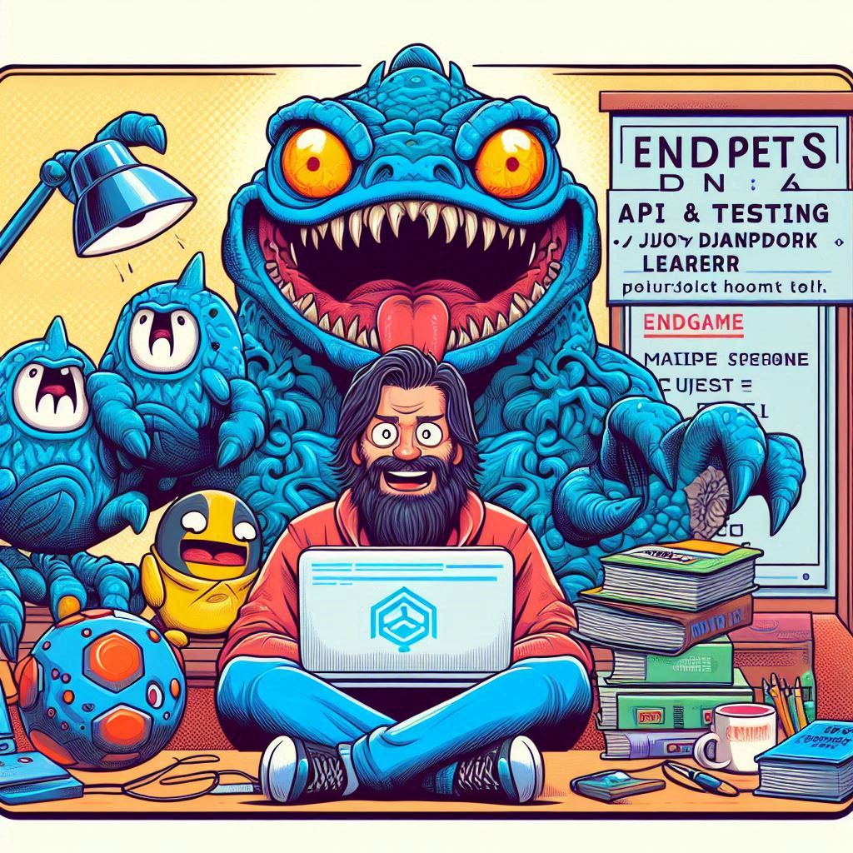
04
API Endpoints & Testing
Notes:
How to use the Thunder Client extension in Visual Studio with a DJANGO API, follow these steps:
Install the Thunder Client extension in Visual Studio. You can do this by opening the Extensions panel, searching for "Thunder Client", and clicking "Install".
Open the DJANGO API project in Visual Studio and ensure that it is running. You should see the DJANGO API homepage displayed in your browser.
Open Thunder Client by clicking on the Thunder Client icon in the Visual Studio toolbar.
Create a new request by clicking the "New Request" button.
In the "Request URL" field, enter the URL for the DJANGO API endpoint you want to test. For example, if you want to test the "users" endpoint, you would enter "http://localhost:8000/users/".
Choose the HTTP method for your request from the dropdown menu (e.g., GET, POST, PUT, DELETE).
Add any necessary headers or query parameters to your request.
If you need to send data in the body of your request (e.g., for a POST or PUT request), enter the data in the "Body" field.
Click the "Send" button to send the request to the DJANGO API.
The response from the DJANGO API will be displayed in the Thunder Client window. You can view the response headers and body, and use the "Test" button to run tests on the response.
That's it! With Thunder Client, you can easily test your DJANGO API endpoints and ensure that they are functioning as expected.

Slide 13
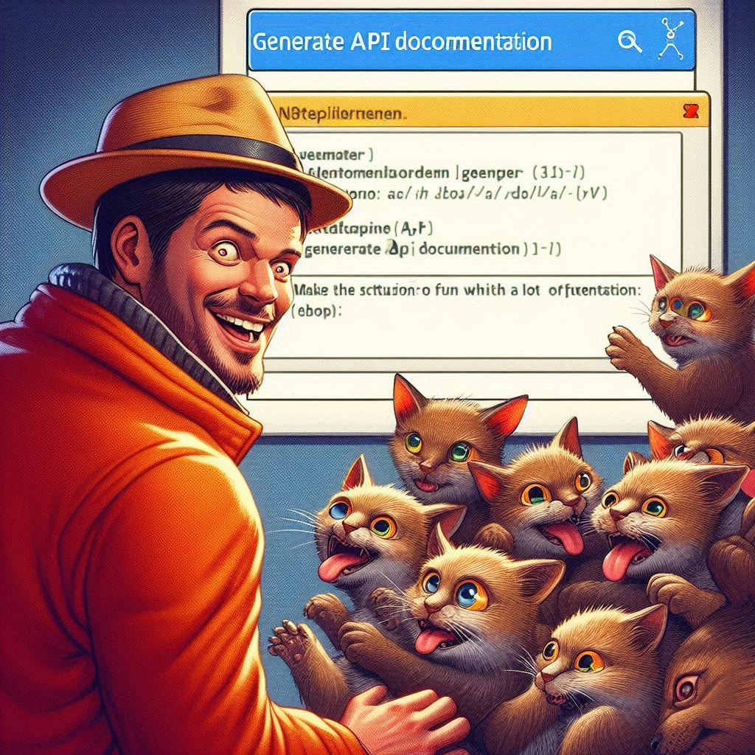
05
Generate API Documentation
Notes:
Yes, Swagger/OpenAPI Specification can document an existing Django API. Here's how you can do it:
Install the django-rest-swagger package in your Django project.
pip install django-rest-swagger
Add rest_framework_swagger to your installed apps in the settings.py file of your Django project.
pythonCopy codeINSTALLED_APPS = (
...
'rest_framework_swagger',
)
Include the rest_framework_swagger URLs in your project's URL configuration.
pythonCopy codefrom django.conf.urls import url, include
from rest_framework_swagger.views import get_swagger_view
schema_view = get_swagger_view(title='API Documentation')
urlpatterns = [
...
url(r'^docs/$', schema_view),
url(r'^api/', include('myapi.urls')),
]
Run your Django project and go to the /docs/ endpoint in your browser. You should see the Swagger UI where you can explore your API and see the generated documentation.
Note that django-rest-swagger generates Swagger documentation based on the Django REST framework's serializers, views, and routers. If your API is built using other frameworks or libraries, you may need to use a different tool or write the Swagger definition manually.

Slide 14

06
Start a New Project
Notes:
STARTING A NEW DJANGO PROJECT
- commands to create project and start server
- what the commands do
- django needs to be running server to access (has built in simple server that would be migrated to Apache/nginix for deployment)
# Step-by-Step Guide to Starting a Django Project
## 1. Set Up the Project Directory
Create a directory for your project and navigate into it. This directory will hold all your project files.
**Linux/Mac/Windows:**
Open your terminal (Command Prompt on Windows, Terminal on Mac/Linux).
mkdir my_project
cd my_project
## 2. Create a Python Virtual Environment
A virtual environment isolates your project’s dependencies, ensuring they do not conflict with other projects.
**Linux/Mac:**
python3 -m venv my_project_venv
**Windows:**
python -m venv my_project_venv
## 3. Activate the Virtual Environment
Activating the virtual environment allows you to use the isolated environment’s Python interpreter and packages.
**Linux/Mac:**
source my_project_venv/bin/activate
**Windows:**
my_project_venv\Scripts\activate.bat
To deactivate the virtual environment (all platforms):
deactivate
## 4. Install Django
Install Django within the virtual environment. The `~=` operator ensures compatibility with all 3.1.x versions.
**All platforms:**
pip install django~=3.1.0
## 5. Start a New Django Project
Create a new Django project named `config` in the current directory. The period (`.`) at the end specifies the current directory.
**All platforms:**
django-admin startproject config .
## 6. Create a Django App
A Django app is a module that handles specific functionality of your project. Create a new app named `app_name`.
**All platforms:**
python manage.py startapp my_app
## 7. Database Migrations
Django uses migrations to propagate changes you make to your models into your database schema.
**All platforms:**
**Create and apply migration files:**
These commands generate and apply the migration files based on the changes you made to your models.
python manage.py makemigrations
python manage.py migrate
## 8. Create a Superuser
The superuser account is used to access the Django admin panel, allowing you to manage your application.
**All platforms:**
python manage.py createsuperuser
Follow the prompts to set up the superuser account (username, email, password).
## 9. Start the Development Server
Run the Django development server to check if everything is set up correctly.
**All platforms:**
python manage.py runserver
Visit `http://127.0.0.1:8000` (or `http://localhost:8000`) in your browser to see your project.
## 10. Manage Project Dependencies
Creating a `requirements.txt` file helps you track your project’s dependencies, making it easier to install them later.
**All platforms:**
**Create `requirements.txt`:**
pip freeze > requirements.txt
**Install dependencies from `requirements.txt`:**
This command installs all the packages listed in the `requirements.txt` file.
pip install -r requirements.txt
## Running an Existing Django Project on Different Platforms
Running an existing Django project on different platforms (Linux, Mac, Windows) requires similar steps, with some platform-specific commands.
### 1. Install Python
Ensure Python is installed on your machine:
- Linux: Python is usually pre-installed. Verify by running python3 --version.
- Mac: Python is usually pre-installed. Verify by running python3 --version.
- Windows: Download and install the latest version from the official website.
### 2. Clone the Project Repository
Clone your project repository or transfer the project files to your machine.
**All platforms:**
git clone https://github.com/yourusername/yourproject.git
cd yourproject
### 3. Create and Activate a Virtual Environment
**Linux/Mac:**
python3 -m venv venv
source venv/bin/activate
**Windows:**
python -m venv venv
venv\Scripts\activate.bat
### 4. Install Project Dependencies
Install the required packages using `requirements.txt`:
**All platforms:**
pip install -r requirements.txt
### 5. Run Database Migrations
Apply the migrations to set up your database schema and run the server if testing/managing through browser.
**All platforms:**
python manage.py makemigrations
python manage.py migrate
python manage.py runserver
ACCESSING AN EXISTING DJANGO PROJECT
- to save an exisiting project, ensure you create a new requirements.txt if any dependencies/libraries changed, then push to git
- cross platform
- clone repo
install python requirement.txt and start the server
To get your Django project up and running on a Windows 10 machine, you can follow these general steps:
Install Python: First, make sure you have Python installed on your Windows 10 machine. You can download the latest version of Python from the official website and install it.
Create a virtual environment: It is recommended to create a virtual environment for your project. Open a command prompt, navigate to your project directory, and run the following command:
python -m venv myenv
This will create a virtual environment named "myenv" in your project directory.
Activate the virtual environment: To activate the virtual environment, run the following command:
myenv\Scripts\activate.bat
This will activate the virtual environment and you will see "(myenv)" at the beginning of the command prompt.
Install requirements: Now, you can install the required packages by running the following command:
pip install -r requirements.txt
This will install all the packages listed in the requirements.txt file.
Migrate the database: If your project uses a database, you need to migrate the database schema. Run the following commands:
python manage.py makemigrations
python manage.py migrate
Run the server: Finally, you can run the Django development server by running the following command:
python manage.py runserver
This will start the server and you can access your project by visiting http://localhost:8000/ in your web browser.
These steps should help you get your Django project up and running on a Windows 10 machine. However, you may encounter some issues, especially if your project uses some platform-specific features or libraries. In that case, you may need to modify your project code or install additional packages to make it work on Windows.
OPTIONAL STEPS TO INSTALL node.js and expo cli - FOR REACT DEVELOPMENT
Install nvm (Node Version Manager):
> curl -o- https://raw.githubusercontent.com/nvm-sh/nvm/v0.39.5/install.sh | bash
Reload your shell configuration:
> source ~/.bashrc
Install the latest Node.js version with the node version manager:
> nvm install node
Verify Node.js installation:
> node -v
Install Expo CLI:
> npm install -g expo-cli
Create a new Expo project:
> expo init project2

Slide 15
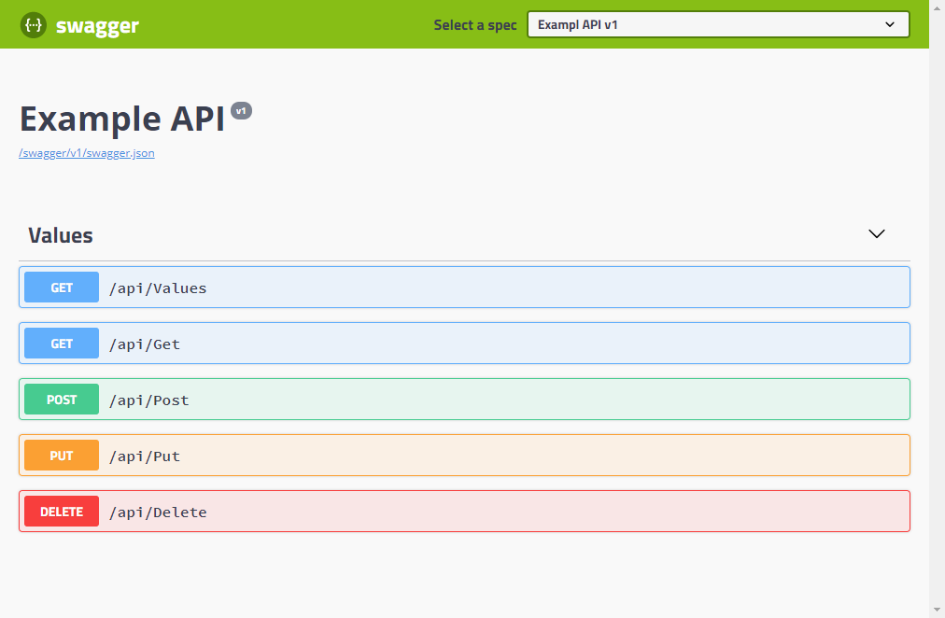
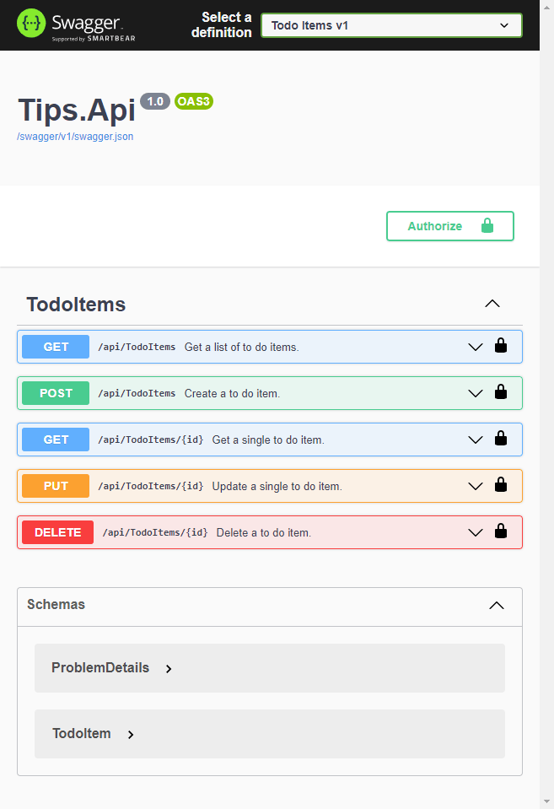

Learning Resources
Django Official:
https://docs.djangoproject.com/en/4.1/intro/tutorial01/ --→ deprecated
W3 Schools:
https://www.w3schools.com/django/
A python + django cheat sheet is available here:
https://dev.to/ericchapman/my-beloved-django-cheat-sheet-2056
Notes:
Django Official:
https://docs.djangoproject.com/en/4.1/intro/tutorial01/ --→ deprecated
W3 Schools:
https://www.w3schools.com/django/
A python + django cheat sheet is available here:
https://dev.to/ericchapman/my-beloved-django-cheat-sheet-2056

Slide 16
Command Cheat Sheet
Installing Dependencies
Creating New Project
Accessing Existing Repo
Jupiter is a gas giant and the biggest planet in the Solar System. It's the fourth-brightest object in the night sky and was named after the Roman god of the skies
Venus has a beautiful name and is the second planet from the Sun. It’s terribly hot and its atmosphere is poisonous. It’s the second-brightest natural object in the night sky
Saturn is a gas giant and has several rings. This planet is composed mostly of hydrogen and helium. It’s the sixth planet from the Sun and was named after a Roman god too
# install python stuff
sudo apt install python venv pip
# install ssh
sudo apt install openssh
# create Django project
django-admin startproject config .
# create app
# create superuser
# run server
# clone the existing repo
git clone https://github.com/<username>/<reponame>.git
# install requirements.txt
pip install -r requirements.txt
# make-a da migrations

Slide 17


Thanks!
Do you have any questions?
lukewait@outlook.com
https://github.com/LukeWait
LinkedIn/LukeWait

Slide 18

APIs and Documentation
You can replace the image on the screen with your own work. Just right-click on it and select “Replace image”

Slide 19






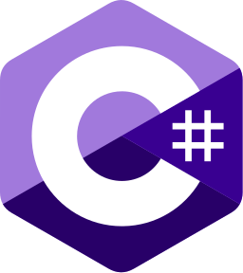
Popular Web Development Frameworks
Django | Ruby on Rails | Laravel | ASP.NET
Python | Ruby | PHP | C#
Example 1 Example 2 Example 3 | Example 1 Example 2 Example 3 | Example 1 Example 2 Example 3 | Example 1 Example 2 Example 3

Slide 20





Popular Front End Frameworks
React | React Native | Flutter | Ionic
JavaScript | JavaScript | Dart | ??
Example 1 Example 2 Example 3 | Example 1 Example 2 Example 3 | Example 1 Example 2 Example 3 | Example 1 Example 2 Example 3

Slide 21
You can divide the content
Mercury
Venus
Mercury is the closest planet to the Sun and the smallest one in the Solar System—it’s only a bit larger than the Moon. This planet’s name has nothing to do with the liquid metal, since Mercury was named after the Roman messenger god
Venus has a beautiful name and is the second planet from the Sun. It’s terribly hot—even hotter than Mercury—and its atmosphere is extremely poisonous. It’s the second-brightest natural object in the night sky after the Moon

Slide 22
Divide the content into four ideas
Mars
Venus
Despite being red, Mars is actually a cold place. It’s full of iron oxide dust, which gives the planet its reddish cast, and it’s made of basalt
Venus has a beautiful name and is the second planet from the Sun. It’s terribly hot and its atmosphere is extremely poisonous
Jupiter
Saturn
Jupiter is a gas giant and the biggest planet in the Solar System. It’s the fourth-brightest object in the night sky and was named after a god
Saturn is a gas giant and has several rings. It’s composed mostly of hydrogen and helium. It’s the sixth planet from the Sun

Slide 23
Reviewing concepts is a good idea
Mars
Venus
Neptune
Despite being red, Mars is actually a cold place. It’s full of iron oxide dust, which gives the planet its reddish cast
Venus has a beautiful name and is the second planet from the Sun. It’s terribly hot, even hotter than Mercury
Neptune is the farthest planet from the Sun. It’s also the fourth-largest planet by diameter in the Solar System
Earth
Saturn
Jupiter
Earth is the third planet from the Sun and the only one in the Solar System that harbors life. We all live on this planet
Saturn is a gas giant and has rings. It's composed mostly of hydrogen and helium. It’s the sixth planet from the Sun
Jupiter is a gas giant and the biggest planet in the Solar System. It’s the fourth-brightest object in the night sky

Slide 24
You can use five columns
Mars
Venus
Despite being red, Mars is actually a cold place. It’s full of iron oxide dust
Venus has a beautiful name and is the second planet from the Sun
Mercury
Saturn
Jupiter
Mercury is the closest planet to the Sun and the smallest of them all
Saturn was named after the Roman god of wealth and agriculture
Jupiter is a gas giant and the biggest planet in the Solar System

Slide 25
Conclusion
Venus
Mars
You can write the details here
You can write the details here
You can write the details here
You can write the details here
You can write the details here
You can write the details here
You can write the details here
You can write the details here
You can write the details here
You can write the details here
You can write the details here
You can write the details here
You can write the details here
You can write the details here
You can write the details here
You can write the details here

Slide 26
A timeline always works well
Step 1
Step 2
Step 3
Step 4
Venus is a hot planet
Mercury is very small
Mars is made of basalt
Jupiter is a gas giant
Step 5
Step 6
Step 7
Step 8
Saturn has rings
The Sun is a star
Earth harbors life
Neptune is an ice giant

Slide 27
Anticipated industry changes
Step 1
Step 2
Step 3
Step 4
Earth is the only planet known to harbor life
Despite being red, Mars is actually a cold place
Jupiter is the biggest planet in the Solar System
Saturn has a high number of moons, like Jupiter

Slide 28
Frameworks for implementation
Neptune
Neptune is the farthest planet from the Sun
Jupiter
Jupiter was named after a Roman god
Digital Transformation
Mercury
Mercury is the closest planet to the Sun
Venus
Venus is the second planet from the Sun

Slide 29
Components of a Web Dev Framework
Backend
A
B
Front End
Model
C
D
Views
Django
Database
E
F
URLs
APIs
G
H
UI/UX

Slide 30
Impact on industries
Venus
Neptune
Venus is the second planet from the Sun
It’s the biggest planet in the Solar System
Jupiter
Saturn
Jupiter doesn’t have a solid surface
Saturn is a gas giant and has several rings
Earth
Mars
Earth is the only planet that harbors life
Despite being red, Mars is actually a cold place

Slide 31
Use tables to represent data
 | Team A | Team B | Team C | Team D | Team E | Team F
Mercury | XX | XX | XX | XX | XX | XX
Mars | XX | XX | XX | XX | XX | XX
Saturn | XX | XX | XX | XX | XX | XX
Venus | XX | XX | XX | XX | XX | XX
Jupiter | XX | XX | XX | XX | XX | XX
Earth | XX | XX | XX | XX | XX | XX
Pluto | XX | XX | XX | XX | XX | XX

Slide 32
Let’s use some percentages
25%
50%
75%
Mercury
Venus
Mars
Mercury is the closest planet to the Sun and the smallest one of them all
Venus has a beautiful name and is the second planet from the Sun
Despite being red, Mars is actually a cold place. It’s full of iron oxide dust

Slide 33
This is a map
Mars
Mars is very cold
Mercury
Mercury is small
Venus
Venus is very hot
Follow the link in the map to modify its data and then paste the new one here. For more info, click here

Slide 34
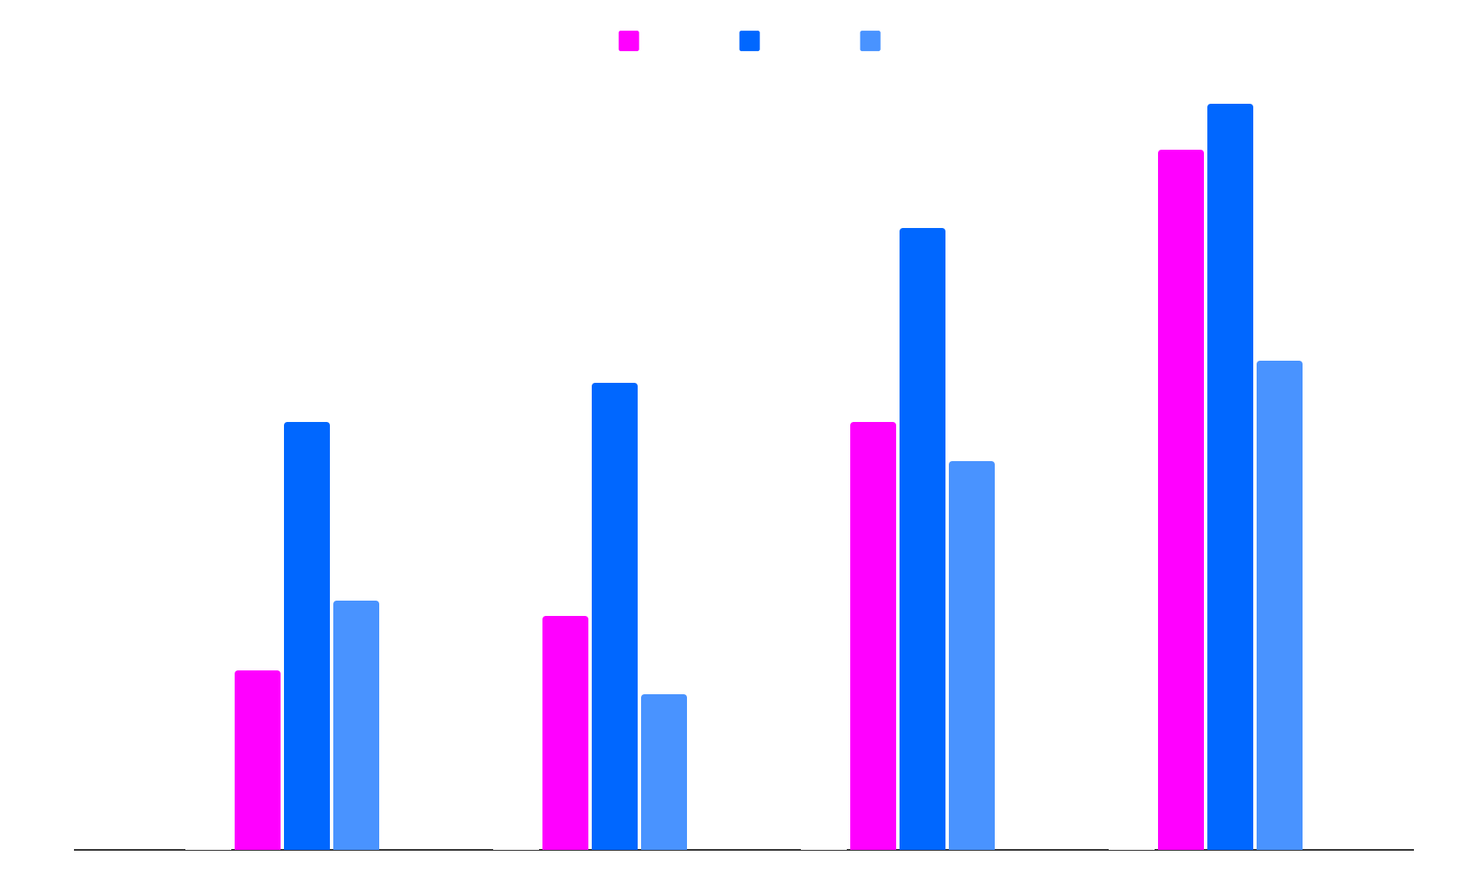
Popular Front End Frameworks
Team 1
Team 2
Team 3
Team 4
Follow the link in the map to modify its data and then paste the new one here. For more info, click here

Slide 35

You can use another graph
10%
30%
Venus
Jupiter
Venus is the second planet from the Sun
It’s the biggest planet in the Solar System
40%
20%
Mars
Saturn
Despite being red, Mars is a cold place
Saturn is a gas giant and has several rings
Follow the link in the map to modify its data and then paste the new one here. For more info, click here

Slide 36


Our team
Sofia Hill
John Harris
You can speak a bit about this person here
You can speak a bit about this person here

Slide 37
— Someone Famous
“This is a quote, words full of wisdom that someone important said and that can inspire the reader”

Slide 38
Awesome words

Slide 39

A picture always reinforces
the concept
Images reveal large amounts of data, so remember: use an image instead of a long text. Your audience will appreciate it

Slide 40


A picture is worth a thousand words

Slide 41
98,300,000
Big numbers catch your audience’s attention

Slide 42

9h 55m 23s
333,000
386,000 km
Jupiter’s rotation period
The Sun’s mass compared to Earth’s
The distance between Earth and the Moon

Slide 43
Contents of this template
You can delete this slide when you’re done editing the presentation
Fonts | To view this template correctly in PowerPoint, download and install the fonts we used
Used and alternative resources | An assortment of graphic resources that are suitable for use in this presentation
Thanks slide | You must keep it so that proper credits for our design are given
Colors | All the colors used in this presentation
Icons and infographic resources | These can be used in the template, and their size and color can be edited
Editable presentation theme | You can edit the master slides easily. For more info, click here
For more info: SLIDESGO | BLOG | FAQs
You can visit our sister projects: FREEPIK | FLATICON | STORYSET | WEPIK | VIDEVO

